Slide 1
Chapter 19
Sorting and Searching

Slide 2
Chapter Goals
To study several sorting and searching algorithms
To appreciate that algorithms for the same task can differ widely in performance
To understand the big-Oh notation
To learn how to estimate and compare the performance of algorithms
To learn how to measure the running time of a program

Slide 3

Selection Sort
Sorts an array by repeatedly finding the smallest element of the unsorted tail region and moving it to the front
Slow when run on large data sets
Example: sorting an array of integers

Slide 4



Sorting an Array of Integers
Find the smallest and swap it with the first element
Find the next smallest. It is already in the correct place
Find the next smallest and swap it with first element of unsorted portion
Continued

Slide 5


Sorting an Array of Integers
Repeat
When the unsorted portion is of length 1, we are done

Slide 6
File SelectionSorter.java
01: /**
02: This class sorts an array, using the selection sort
03: algorithm
04: */
05: public class SelectionSorter
06: {
07: /**
08: Constructs a selection sorter.
09: @param anArray the array to sort
10: */
11: public SelectionSorter(int[] anArray)
12: {
13: a = anArray;
14: }
15:
16: /**
17: Sorts the array managed by this selection sorter.
18: */
Continued

Slide 7
File SelectionSorter.java
19: public void sort()
20: {
21: for (int i = 0; i < a.length - 1; i++)
22: {
23: int minPos = minimumPosition(i);
24: swap(minPos, i);
25: }
26: }
27:
28: /**
29: Finds the smallest element in a tail range of the array.
30: @param from the first position in a to compare
31: @return the position of the smallest element in the
32: range a[from] . . . a[a.length - 1]
33: */
34: private int minimumPosition(int from)
35: {
Continued

Slide 8
File SelectionSorter.java
36: int minPos = from;
37: for (int i = from + 1; i < a.length; i++)
38: if (a[i] < a[minPos]) minPos = i;
39: return minPos;
40: }
41:
42: /**
43: Swaps two entries of the array.
44: @param i the first position to swap
45: @param j the second position to swap
46: */
47: private void swap(int i, int j)
48: {
49: int temp = a[i];
50: a[i] = a[j];
51: a[j] = temp;
52: }
Continued

Slide 9
File SelectionSorter.java
53:
54: private int[] a;
55: }

Slide 10
File SelectionSortTester.java
01: /**
02: This program tests the selection sort algorithm by
03: sorting an array that is filled with random numbers.
04: */
05: public class SelectionSortTester
06: {
07: public static void main(String[] args)
08: {
09: int[] a = ArrayUtil.randomIntArray(20, 100);
10: ArrayUtil.print(a);
11:
12: SelectionSorter sorter = new SelectionSorter(a);
13: sorter.sort();
14:
Continued

Slide 11
File SelectionSortTester.java
15: ArrayUtil.print(a);
16: }
17: }
18:
19:

Slide 12
File ArrayUtil.java
01: import java.util.Random;
02:
03: /**
04: This class contains utility methods for array
05: manipulation.
06: */
07: public class ArrayUtil
08: {
09: /**
10: Creates an array filled with random values.
11: @param length the length of the array
12: @param n the number of possible random values
13: @return an array filled with length numbers between
14: 0 and n – 1
15: */
16: public static int[] randomIntArray(int length, int n)
17: {
Continued

Slide 13
File SelectionSortTester.java
18: int[] a = new int[length];
19: for (int i = 0; i < a.length; i++)
20: a[i] = generator.nextInt(n);
21:
22: return a;
23: }
24:
25: /**
26: Prints all elements in an array.
27: @param a the array to print
28: */
29: public static void print(int[] a)
30: {
Continued

Slide 14
File SelectionSortTester.java
31: for (int e : a)
32: System.out.print(e + " ");
33: System.out.println();
34: }
35:
36: private static Random generator = new Random();
37: }
38:

Slide 15
File SelectionSortTester.java
Output:
65 46 14 52 38 2 96 39 14 33 13 4 24 99 89 77 73 87 36 81
2 4 13 14 14 24 33 36 38 39 46 52 65 73 77 81 87 89 96 99

Slide 16
Self Check
Why do we need the temp variable in the swap method? What would happen if you simply assigned a[i] to a[j] and a[j] to a[i]?
What steps does the selection sort algorithm go through to sort the sequence
6 5 4 3 2 1?

Slide 17
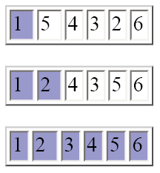
Answers
Dropping the temp variable would not work. Then a[i] and a[j] would end up being the same value.

Slide 18
Profiling the Selection Sort Algorithm
We want to measure the time the algorithm takes to execute
  Exclude the time the program takes to load
  Exclude output time
Create a StopWatch class to measure execution time of an algorithm
  It can start, stop and give elapsed time
  Use System.currentTimeMillis method
Continued

Slide 19
Profiling the Selection Sort Algorithm
Create a StopWatch object
  Start the stopwatch just before the sort
  Stop the stopwatch just after the sort
  Read the elapsed time

Slide 20
File StopWatch.java
01: /**
02: A stopwatch accumulates time when it is running. You can
03: repeatedly start and stop the stopwatch. You can use a
04: stopwatch to measure the running time of a program.
05: */
06: public class StopWatch
07: {
08: /**
09: Constructs a stopwatch that is in the stopped state
10: and has no time accumulated.
11: */
12: public StopWatch()
13: {
14: reset();
15: }
16:
Continued

Slide 21
File StopWatch.java
17: /**
18: Starts the stopwatch. Time starts accumulating now.
19: */
20: public void start()
21: {
22: if (isRunning) return;
23: isRunning = true;
24: startTime = System.currentTimeMillis();
25: }
26:
27: /**
28: Stops the stopwatch. Time stops accumulating and is
29: is added to the elapsed time.
30: */
31: public void stop()
32: {
Continued

Slide 22
File StopWatch.java
33: if (!isRunning) return;
34: isRunning = false;
35: long endTime = System.currentTimeMillis();
36: elapsedTime = elapsedTime + endTime - startTime;
37: }
38:
39: /**
40: Returns the total elapsed time.
41: @return the total elapsed time
42: */
43: public long getElapsedTime()
44: {
45: if (isRunning)
46: {
47: long endTime = System.currentTimeMillis();
48: return elapsedTime + endTime - startTime;
49: }
Continued

Slide 23
File StopWatch.java
50: else
51: return elapsedTime;
52: }
53:
54: /**
55: Stops the watch and resets the elapsed time to 0.
56: */
57: public void reset()
58: {
59: elapsedTime = 0;
60: isRunning = false;
61: }
62:
63: private long elapsedTime;
64: private long startTime;
65: private boolean isRunning;
66: }

Slide 24
File SelectionSortTimer
01: import java.util.Scanner;
02:
03: /**
04: This program measures how long it takes to sort an
05: array of a user-specified size with the selection
06: sort algorithm.
07: */
08: public class SelectionSortTimer
09: {
10: public static void main(String[] args)
11: {
12: Scanner in = new Scanner(System.in);
13: System.out.print("Enter array size: ");
14: int n = in.nextInt();
15:
16: // Construct random array
17:
Continued

Slide 25
File SelectionSortTimer
18: int[] a = ArrayUtil.randomIntArray(n, 100);
19: SelectionSorter sorter = new SelectionSorter(a);
20:
21: // Use stopwatch to time selection sort
22:
23: StopWatch timer = new StopWatch();
24:
25: timer.start();
26: sorter.sort();
27: timer.stop();
28:
29: System.out.println("Elapsed time: "
30: + timer.getElapsedTime() + " milliseconds");
31: }
32: }
33:
34:
Continued

Slide 26
File SelectionSortTester.java
Output:
Enter array size: 100000
Elapsed time: 27880 milliseconds

Slide 27
Selection Sort on Various Size Arrays*
n | Milliseconds
10,000 | 772
20,000 | 3,051
30,000 | 6,846
40,000 | 12,188
50,000 | 19,015
60,000 | 27,359
*Obtained with a Pentium processor, 1.2 GHz, Java 5.0, Linux

Slide 28
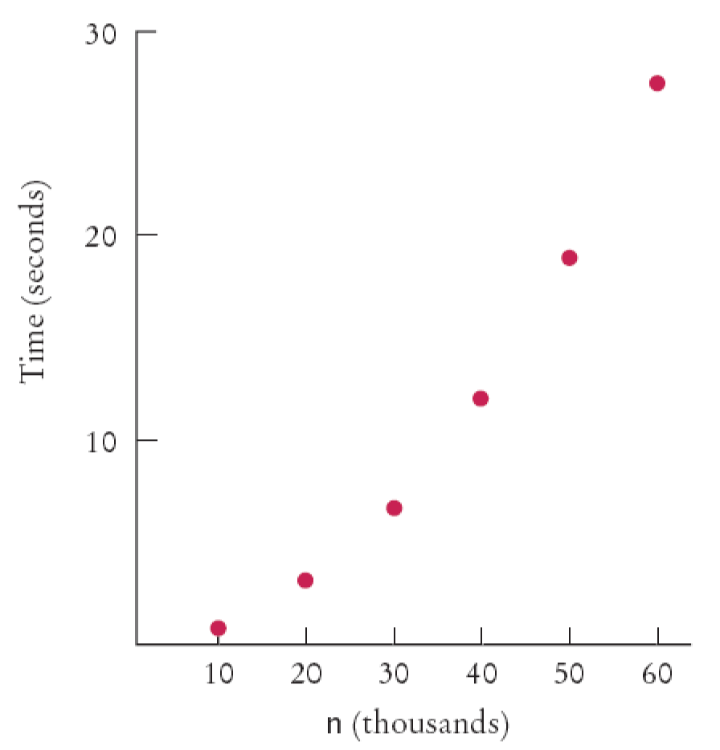
Selection Sort on Various Size Arrays
Figure 1:
Time Taken by Selection Sort

Slide 29
Selection Sort on Various Size Arrays
Doubling the size of the array more than
doubles the time needed to sort it

Slide 30
Self Check
Approximately how many seconds would it take to sort a data set of 80,000 values?
Look at the graph in Figure 1. What mathematical shape does it resemble?

Slide 31
Answers
Four times as long as 40,000 values, or about 50 seconds.
A parabola.

Slide 32
Analyzing the Performance of the Selection Sort Algorithm
In an array of size n, count how many times an array element is visited
  To find the smallest, visit n elements + 2 visits for the swap
  To find the next smallest, visit (n - 1) elements + 2 visits for the swap
  The last term is 2 elements visited to find the smallest + 2 visits for the swap

Slide 33
Analyzing the Performance of the Selection Sort Algorithm
The number of visits:
  n + 2 + (n - 1) + 2 + (n - 2) + 2 + . . .+ 2 + 2
  This can be simplified to n2 /2 + 5n/2 - 3
  5n/2 - 3 is small compared to n2 /2 – so let's ignore it
  Also ignore the 1/2 – it cancels out when comparing ratios

Slide 34
Analyzing the Performance of the Selection Sort Algorithm
The number of visits is of the order n²
Using big-Oh notation: The number of visits is O(n²)
Multiplying the number of elements in an array by 2 multiplies the processing time by 4
Big-Oh notation "f(n) = O(g(n))"
expresses that f grows no faster than g
To convert to big-Oh notation: locate fastest-growing term, and ignore constant coefficient

Slide 35
Self Check
If you increase the size of a data set tenfold, how much longer does it take to sort it with the selection sort algorithm?
How large does n need to be so that n²/2 is bigger than 5n²/2 - 3?

Slide 36
Answers
It takes about 100 times longer.
If n is 4, then n²/2 is 8 and 5n²/2 - 3 is 7.

Slide 37



Insertion Sort
Assume initial sequence a[0] . . . a[k] is sorted (k = 0):
Add a[1]; element needs to be inserted before 11
Add a[2]

Slide 38


Insertion Sort
Add a[3]
Finally, add a[4]

Slide 39
File InsertionSorter.java
01: /**
02: This class sorts an array, using the insertion sort
03: algorithm
04: */
05: public class InsertionSorter
06: {
07: /**
08: Constructs an insertion sorter.
09: @param anArray the array to sort
10: */
11: public InsertionSorter(int[] anArray)
12: {
13: a = anArray;
14: }
15:
16: /**
17: Sorts the array managed by this insertion sorter
18: */
Continued

Slide 40
File InsertionSorter.java
19: public void sort()
20: {
21: for (int i = 1; i < a.length; i++)
22: {
23: int next = a[i];
24: // Move all larger elements up
25: int j = i;
26: while (j > 0 && a[j - 1] > next)
27: {
28: a[j] = a[j - 1];
29: j--;
30: }
31: // Insert the element
32: a[j] = next;
33: }
34: }
35:
36: private int[] a;
37: }

Slide 41
Merge Sort
Sorts an array by
  Cutting the array in half
  Recursively sorting each half
  Merging the sorted halves
Dramatically faster than the selection sort

Slide 42


Merge Sort Example
Divide an array in half and sort each half
Continued

Slide 43
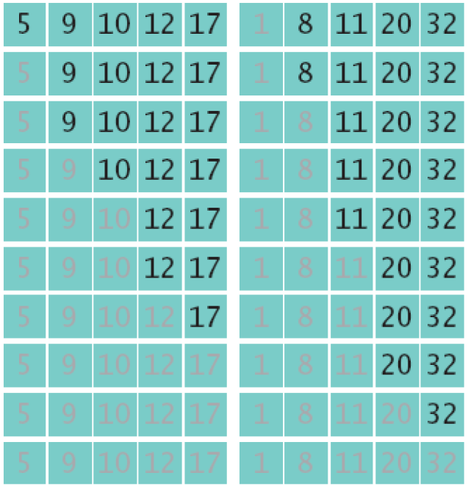
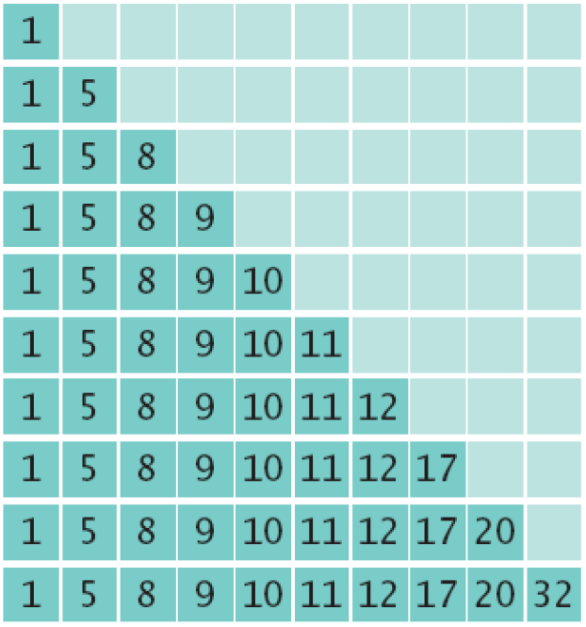
Merge Sort Example
Merge the two sorted arrays into a single sorted array

Slide 44
Merge Sort
public void sort()
{
if (a.length <= 1) return;
int[] first = new int[a.length / 2];
int[] second = new int[a.length - first.length];
System.arraycopy(a, 0, first, 0, first.length);
System.arraycopy(a, first.length, second, 0, second.length);
MergeSorter firstSorter = new MergeSorter(first);
MergeSorter secondSorter = new MergeSorter(second);
firstSorter.sort();
secondSorter.sort();
merge(first, second);
}

Slide 45
File MergeSorter.java
01: /**
02: This class sorts an array, using the merge sort algorithm.
03: */
04: public class MergeSorter
05: {
06: /**
07: Constructs a merge sorter.
08: @param anArray the array to sort
09: */
10: public MergeSorter(int[] anArray)
11: {
12: a = anArray;
13: }
14:
15: /**
16: Sorts the array managed by this merge sorter.
17: */
Continued

Slide 46
File MergeSorter.java
18: public void sort()
19: {
20: if (a.length <= 1) return;
21: int[] first = new int[a.length / 2];
22: int[] second = new int[a.length - first.length];
23: System.arraycopy(a, 0, first, 0, first.length);
24: System.arraycopy(a, first.length, second, 0,
second.length);
25: MergeSorter firstSorter = new MergeSorter(first);
26: MergeSorter secondSorter = new MergeSorter(second);
27: firstSorter.sort();
28: secondSorter.sort();
29: merge(first, second);
30: }
31:
Continued

Slide 47
File MergeSorter.java
32: /**
33: Merges two sorted arrays into the array managed by
34: this merge sorter.
35: @param first the first sorted array
36: @param second the second sorted array
37: */
38: private void merge(int[] first, int[] second)
39: {
40: // Merge both halves into the temporary array
41:
42: int iFirst = 0;
43: // Next element to consider in the first array
44: int iSecond = 0;
45: // Next element to consider in the second array
46: int j = 0;
47: // Next open position in a
48:
Continued

Slide 48
File MergeSorter.java
49: // As long as neither iFirst nor iSecond past the
50: // end, move the smaller element into a
51: while (iFirst < first.length && iSecond < second.length)
52: {
53: if (first[iFirst] < second[iSecond])
54: {
55: a[j] = first[iFirst];
56: iFirst++;
57: }
58: else
59: {
60: a[j] = second[iSecond];
61: iSecond++;
62: }
63: j++;
64: }
65:
Continued

Slide 49
File MergeSorter.java
66: // Note that only one of the two calls to arraycopy
67: // below copies entries
68:
69: // Copy any remaining entries of the first array
70: System.arraycopy(first, iFirst, a, j,
first.length - iFirst);
71:
72: // Copy any remaining entries of the second half
73: System.arraycopy(second, iSecond, a, j,
second.length - iSecond);
74: }
75:
76: private int[] a;
77: }

Slide 50
File MergeSortTester.java
01: /**
02: This program tests the merge sort algorithm by
03: sorting an array that is filled with random numbers.
04: */
05: public class MergeSortTester
06: {
07: public static void main(String[] args)
08: {
09: int[] a = ArrayUtil.randomIntArray(20, 100);
10: ArrayUtil.print(a);
11: MergeSorter sorter = new MergeSorter(a);
12: sorter.sort();
13: ArrayUtil.print(a);
14: }
15: }
16:
Continued

Slide 51
File MergeSortTester.java
Output:
8 81 48 53 46 70 98 42 27 76 33 24 2 76 62 89 90 5 13 21
2 5 8 13 21 24 27 33 42 46 48 53 62 70 76 76 81 89 90 98

Slide 52
Self Check
Why does only one of the two arraycopy calls at the end of the merge method do any work?
Manually run the merge sort algorithm on the array 8 7 6 5 4 3 2 1.

Slide 53
Answers
When the preceding while loop ends, the loop condition must be false, that is,
iFirst >= first.length or iSecond >= second.length (De Morgan's Law).
Then first.length - iFirst <= 0 or iSecond.length - iSecond <= 0.
Continued

Slide 54
Answers
First sort 8 7 6 5.
Recursively, first sort 8 7.
Recursively, first sort 8. It's sorted.
Sort 7. It's sorted.
Merge them: 7 8.
Do the same with 6 5 to get 5 6.
Merge them to 5 6 7 8.
continued on next slide…

Slide 55
Answers
(continued)…
Do the same with 4 3 2 1: Sort 4 3 by sorting 4 and 3 and merging them to 3 4.
Sort 2 1 by sorting 2 and 1 and merging them to 1 2.
Merge 3 4 and 1 2 to 1 2 3 4.
Finally, merge 5 6 7 8 and 1 2 3 4 to 1 2 3 4 5 6 7 8.

Slide 56
Analyzing the Merge Sort Algorithm
n | Merge Sort (milliseconds) | Selection Sort (milliseconds)
10,000 | 31 | 772
20,000 | 47 | 3,051
30,000 | 62 | 6,846
40,000 | 80 | 12,188
50,000 | 97 | 19,015
60,000 | 113 | 27,359

Slide 57
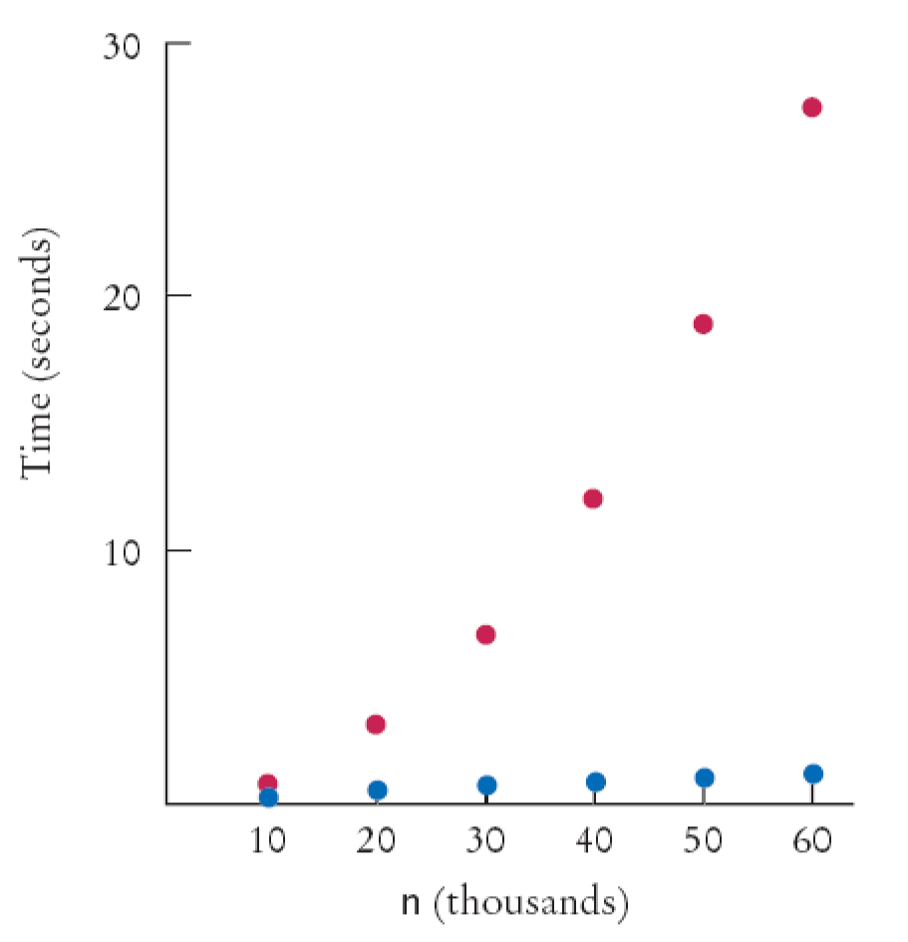
Merge Sort Timing vs. Selection Sort
Figure 2:
Merge Sort Timing (blue) versus Selection Sort (red)

Slide 58
Analyzing the Merge Sort Algorithm
In an array of size n, count how many times an array element is visited
Assume n is a power of 2: n = 2^{m}
Calculate the number of visits to create the two sub-arrays and then merge the two sorted arrays
  3 visits to merge each element or 3n visits
  2n visits to create the two sub-arrays
  total of 5n visits

Slide 59
Analyzing the Merge Sort Algorithm
Let T(n) denote the number of visits to sort an array of n elements then
  T(n) = T(n/2) + T(n/2) + 5n or
  T(n) = 2T(n/2) + 5n
The visits for an array of size n/2 is:
T(n/2) = 2T(n/4) + 5n/2
  So T(n) = 2 × 2T(n/4) +5n + 5n
The visits for an array of size n/4 is:
T(n/4) = 2T(n/8) + 5n/4
  So T(n) = 2 × 2 × 2T(n/8) + 5n + 5n + 5n

Slide 60
Analyzing the Merge Sort Algorithm
Repeating the process k times:
T(n) = 2^{k}T(n/2^{k}) +5nk
since n = 2^{m}, when k = m:
T(n) = 2^{m}T(n/2^{m}) +5nm
T(n) = nT(1) +5nm
T(n) = n + 5nlog₂(n)

Slide 61
Analyzing the Merge Sort Algorithm
To establish growth order
  Drop the lower-order term n
  Drop the constant factor 5
  Drop the base of the logarithm since
  all logarithms are related by a constant factor
  We are left with n log(n)
Using big-Oh notation: number of visits is O(nlog(n))

Slide 62
Merge Sort Vs Selection Sort
Selection sort is an O(n²) algorithm
Merge sort is an O(nlog(n)) algorithm
The nlog(n) function grows much more slowly than n²

Slide 63
Sorting in a Java Program
The Arrays class implements a sorting method
To sort an array of integers
That sort method uses the Quicksort algorithm (see Advanced Topic 19.3)
int[] a = . . . ;
Arrays.sort(a);

Slide 64
Self Check
Given the timing data for the merge sort algorithm in the table at the beginning of this section, how long would it take to sort an array of 100,000 values?
Suppose you have an array double[] values in a Java program. How would you sort it?

Slide 65
Answers
Approximately 100,000 × log(100,000) / 50,000 × log(50,000) = 2 × 5 / 4.7 = 2.13 times the time required for 50,000 values. That's 2.13 × 97 milliseconds or approximately 207 milliseconds.
By calling Arrays.sort(values).

Slide 66
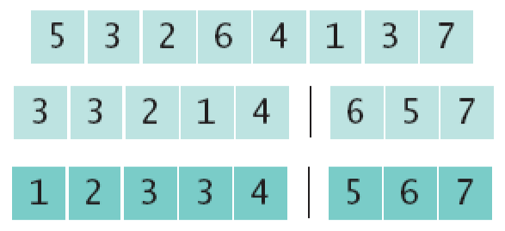
The Quicksort Algorithm
Divide and conquer
  Partition the range
  Sort each partition

Slide 67
The Quicksort Algorithm
public void sort(int from, int to)
{
if (from >= to) return;
int p = partition(from, to);
sort(from, p);
sort(p + 1, to);
}

Slide 68
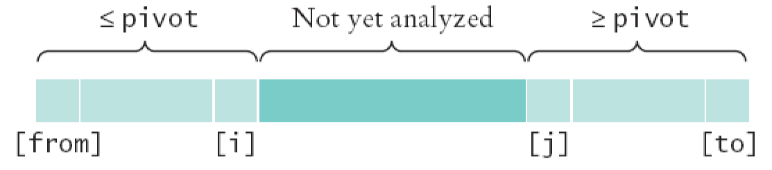
The Quicksort Algorithm
Figure 3:
Partitioning a Range

Slide 69
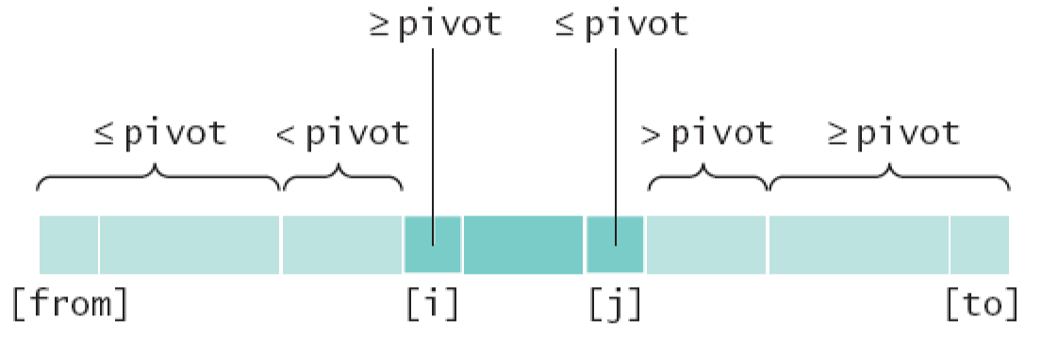
The Quicksort Algorithm
Figure 4:
Extending the Partitions

Slide 70
The Quicksort Algorithm
private int partition(int from, int to)
{
int pivot = a[from];
int i = from - 1;
int j = to + 1;
while (i < j)
{
i++; while (a[i] < pivot) i++;
j--; while (a[j] > pivot) j--;
if (i < j) swap(i, j);
}
return j;
}

Slide 71
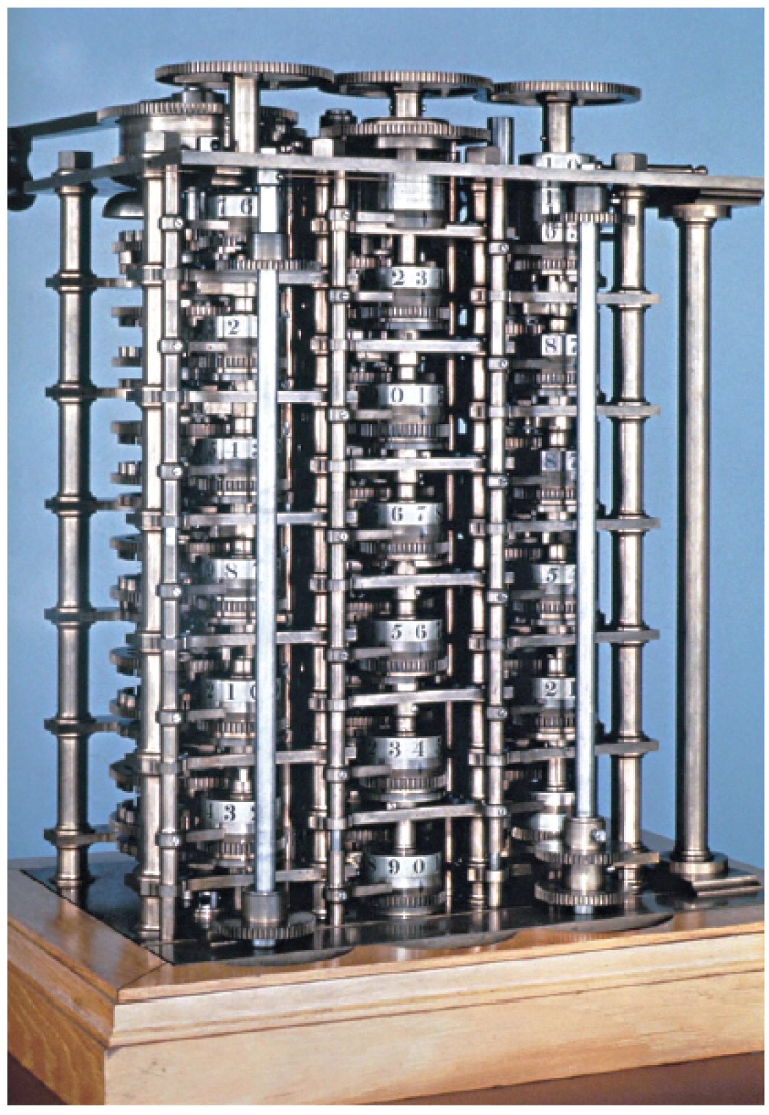
The First Programmer
Figure 5:
Babbage's Difference Engine

Slide 72
Searching
Linear search: also called sequential search
Examines all values in an array until it finds a match or reaches the end
Number of visits for a linear search of an array of n elements:
  The average search visits n/2 elements
  The maximum visits is n
A linear search locates a value in an array in O(n) steps

Slide 73
File LinearSearcher.java
01: /**
02: A class for executing linear searches through an array.
03: */
04: public class LinearSearcher
05: {
06: /**
07: Constructs the LinearSearcher.
08: @param anArray an array of integers
09: */
10: public LinearSearcher(int[] anArray)
11: {
12: a = anArray;
13: }
14:
15: /**
16: Finds a value in an array, using the linear search
17: algorithm.
Continued

Slide 74
File LinearSearcher.java
18: @param v the value to search
19: @return the index at which the value occurs, or -1
20: if it does not occur in the array
21: */
22: public int search(int v)
23: {
24: for (int i = 0; i < a.length; i++)
25: {
26: if (a[i] == v)
27: return i;
28: }
29: return -1;
30: }
31:
32: private int[] a;
33: }

Slide 75
File LinearSearchTester.java
01: import java.util.Scanner;
02:
03: /**
04: This program tests the linear search algorithm.
05: */
06: public class LinearSearchTester
07: {
08: public static void main(String[] args)
09: {
10: // Construct random array
11:
12: int[] a = ArrayUtil.randomIntArray(20, 100);
13: ArrayUtil.print(a);
14: LinearSearcher searcher = new LinearSearcher(a);
15:
16: Scanner in = new Scanner(System.in);
17:
Continued

Slide 76
File LinearSearchTester.java
18: boolean done = false;
19: while (!done)
20: {
21: System.out.print("Enter number to search for,
-1 to quit: ");
22: int n = in.nextInt();
23: if (n == -1)
24: done = true;
25: else
26: {
27: int pos = searcher.search(n);
28: System.out.println("Found in position " + pos);
29: }
30: }
31: }
32: }
Continued

Slide 77
File LinearSearchTester.java
Output:
46 99 45 57 64 95 81 69 11 97 6 85 61 88 29 65 83 88 45 88
Enter number to search for, -1 to quit: 11
Found in position 8

Slide 78
Self Check
Suppose you need to look through 1,000,000 records to find a telephone number. How many records do you expect to search before finding the number?
Why can't you use a "for each" loop for (int element : a) in the search method?

Slide 79
Answers
On average, you'd make 500,000 comparisons.
The search method returns the index at which the match occurs, not the data stored at that location.

Slide 80
Binary Search
Locates a value in a sorted array by
  Determining whether the value occurs in the first or second half
  Then repeating the search in one of the halves

Slide 81
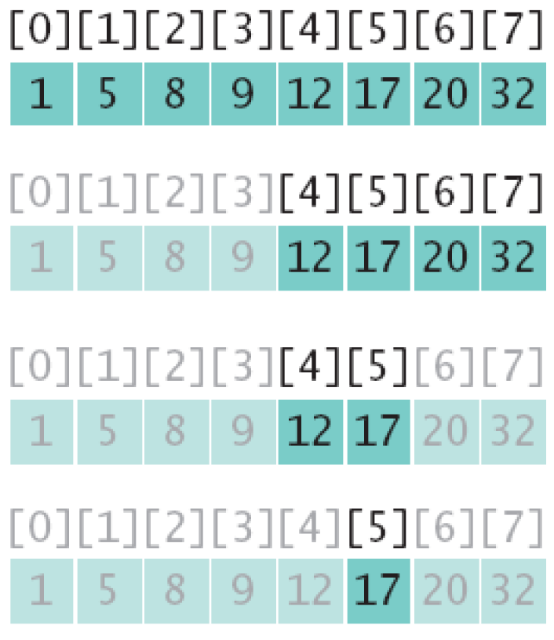
Binary Search
15 ≠ 17: we don't have a match

Slide 82
File BinarySearcher.java
01: /**
02: A class for executing binary searches through an array.
03: */
04: public class BinarySearcher
05: {
06: /**
07: Constructs a BinarySearcher.
08: @param anArray a sorted array of integers
09: */
10: public BinarySearcher(int[] anArray)
11: {
12: a = anArray;
13: }
14:
15: /**
16: Finds a value in a sorted array, using the binary
17: search algorithm.
Continued

Slide 83
File BinarySearcher.java
18: @param v the value to search
19: @return the index at which the value occurs, or -1
20: if it does not occur in the array
21: */
22: public int search(int v)
23: {
24: int low = 0;
25: int high = a.length - 1;
26: while (low <= high)
27: {
28: int mid = (low + high) / 2;
29: int diff = a[mid] - v;
30:
31: if (diff == 0) // a[mid] == v
32: return mid;
33: else if (diff < 0) // a[mid] < v
34: low = mid + 1;
Continued

Slide 84
File BinarySearcher.java
35: else
36: high = mid - 1;
37: }
38: return -1;
39: }
40:
41: private int[] a;
42: }
43:

Slide 85
Binary Search
Count the number of visits to search an sorted array of size n
  We visit one element (the middle element) then search either the left or right subarray
  Thus: T(n) = T(n/2) + 1
If n is n/2, then T(n/2) = T(n/4) + 1
Substituting into the original equation:
T(n) = T(n/4) + 2
This generalizes to: T(n) = T(n/2^{k}) + k

Slide 86
Binary Search
Assume n is a power of 2, n = 2^{m}
where m = log₂(n)
Then: T(n) = 1 + log₂(n)
Binary search is an O(log(n)) algorithm

Slide 87
Searching a Sorted Array in a Program
The Arrays class contains a static binarySearch method
The method returns either
  The index of the element, if element is found
  Or -k - 1 where k is the position before which
  the element should be inserted
int[] a = { 1, 4, 9 };
int v = 7;
int pos = Arrays.binarySearch(a, v);
// Returns -3; v should be inserted before position 2

Slide 88
Self Check
Suppose you need to look through a sorted array with 1,000,000 elements to find a value. Using the binary search algorithm, how many records do you expect to search before finding the value?
Why is it useful that the Arrays.binarySearch method indicates the position where a missing element should be inserted?
Continued

Slide 89
Self Check
Why does Arrays.binarySearch return
-k - 1 and not -k to indicate that a value is not present and should be inserted before position k?

Slide 90
Answers
You would search about 20. (The binary log of 1,024 is 10.)
Then you know where to insert it so that the array stays sorted, and you can keep using binary search.
Otherwise, you would not know whether a value is present when the method returns 0.

Slide 91
Sorting Real Data
Arrays.sort sorts objects of classes that
implement Comparable interface
The call a.compareTo(b) returns
  A negative number is a should come before b
  0 if a and b are the same
  A positive number otherwise
public interface Comparable
{
int compareTo(Object otherObject);
}

Slide 92
Sorting Real Data
Several classes in Java (e.g. String and Date) implement Comparable
You can implement Comparable interface for your own classes
public class Coin implements Comparable
{
. . .
public int compareTo(Object otherObject)
{
Coin other = (Coin) otherObject;
if (value < other.value) return -1;
if (value == other.value) return 0;
return 1;
}
. . .
}

Slide 93
CompareTo Method
The implementation must define a total ordering relationship
  Antisymmetric
  If a.compareTo(b) = 0, then b.compareTo(a) = 0
  Reflexive
  a.compareTo(a) = 0
Continued

Slide 94
CompareTo Method
The implementation must define a total ordering relationship
  Transitive
  If a.compareTo(b) = 0 and b.compareTo(c) = 0, then a.compareTo(c) = 0

Slide 95
Sorting Real Data
Once your class implements Comparable, simply use the Arrays.sort method:
Coin[] coins = new Coin[n];
// Add coins
. . .
Arrays.sort(coins);
Continued

Slide 96
Sorting Real Data
If the objects are stored in an ArrayList, use Collections.sort uses the merge sort algorithm
Collections.sort uses the merge sort algorithm
Collections.sort: ArrayList<Coin> coins = new ArrayList<Coin>();
// Add coins
. . .
Collections.sort(coins);

Slide 97
Self Check
Why can't the Arrays.sort method sort an array of Rectangle objects?
What steps would you need to take to sort an array of BankAccount objects by increasing balance?

Slide 98
Answers
The Rectangle class does not implement the Comparable interface.
The BankAccount class needs to implement the Comparable interface. Its compareTo method must compare the bank balances.

